Slide 1
Why Sleep Matters
Paul Barrett - Head of Wellbeing

Slide 2
About us
Who we support
BWC exist to support the health and wellbeing of current and former bank workers and their families
The banking community makes up nearly 3% of the UK population. Across the UK there are 2 million people connected to banking, including former employees, their families, children and dependents
We are entirely independent of the banks and our services are free and confidential

Slide 3
BWC services
What we offer includes
Help in managing mental health
Help with issues around disability or caring for someone
Assistance in accessing welfare benefits
Help with financial problems
Counselling for personal relationships
Bereavement counselling

Slide 4
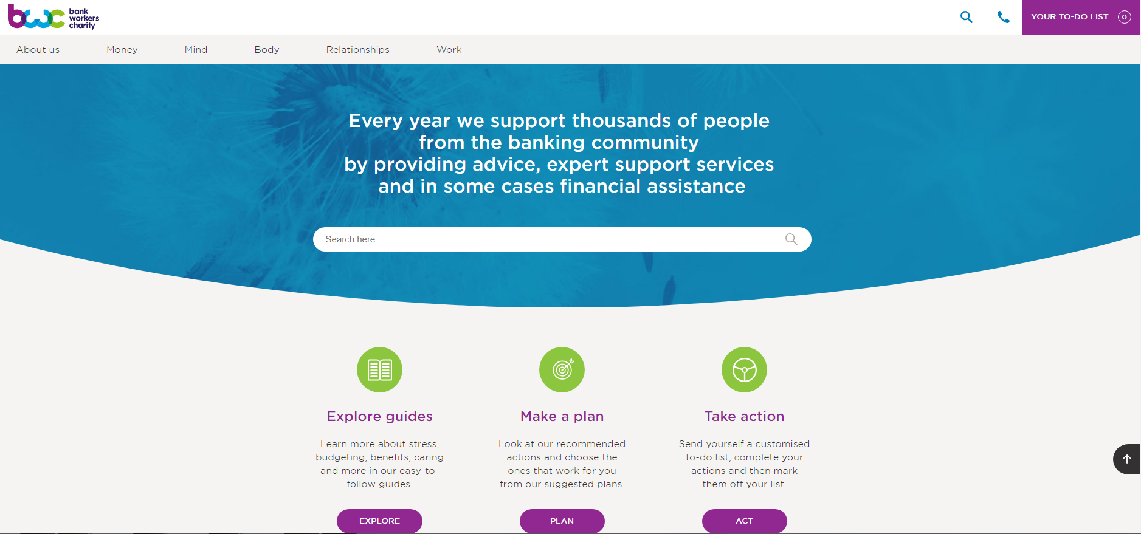
BWC Website

Slide 5
Sleep issues during the pandemic
UK Study published during first UK lockdown found people were getting an hour more sleep than before.
But nearly 1 in 4 in said sleep was "worse than ever”
As many as 48% were kept awake worrying about coronavirus
27 % felt lethargic and 23% felt tired when they woke up
But new UCL study found sleep problems have increased. Fewer than 1 in 10 adults have been able to sleep well during the 3 lockdowns
People now less worried about catching the virus. The biggest obstacles to sleep are money worries and fears for job security
27% of people are looking at screens closer to bedtime more often, causing them to have worse sleep.
People across the world are reporting remembering more dreams, with many experiencing more vivid dreams and nightmares

Slide 6
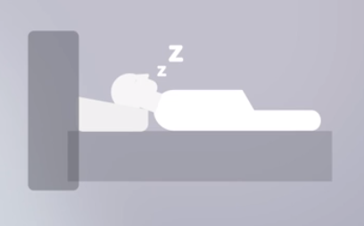
What is sleep – why do we need it?
Building connections with other parts of the brain to absorb new experiences
Getting rid of waste matter from the brain
Consolidating memories and retaining information
Restoring and rejuvenating our bodies
It’s necessary for survival
.

Slide 7
Common sleep disorders
.
Insomnias- difficulty getting to sleep, staying asleep and waking up
Hyper-somnias - sleep disorders that causes a person to be excessively sleepy
Sleep-related breathing disorders – Apnoea, when breathing is inhibited by blocked
airways and other problems.
Circadian Rhythm, sleep-wake disorders - involve conditions in which the sleep times are out of synch
Parasomnias - involve unwanted events or experiences that occur while you are falling asleep, sleeping or waking up.
Sleep movement disorders – cause movement during sleep or just as people are falling asleep
**** If you think you may have a sleep disorder talk to your GP

Slide 8
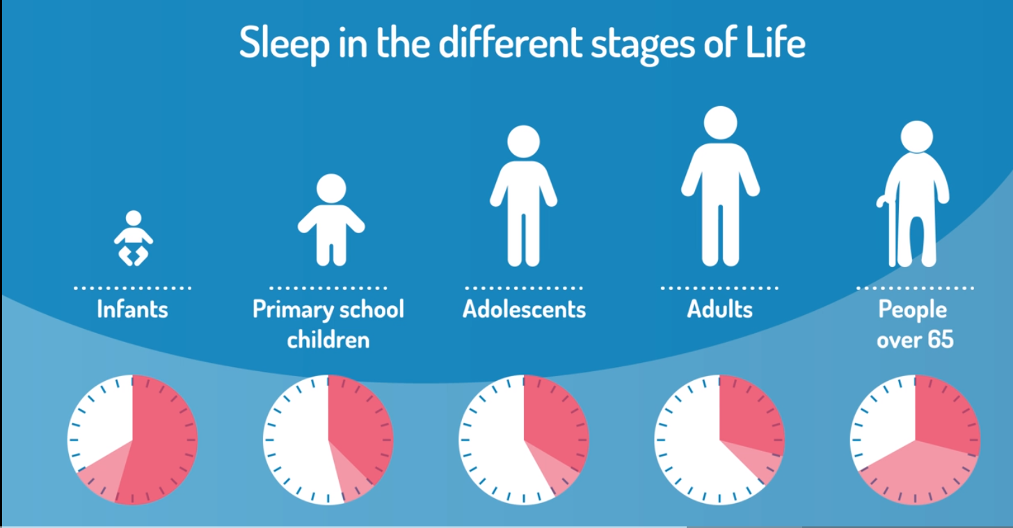
Source – the Sleep Council

Slide 9
How sleep needs change with age
The role of sleep changes and so does the amount people need at every stage of life, from infancy to old age.
Infants - need lots of sleep as their brain develops. They need between 12 -18 hours in the first year of their lives.
Primary school children - 9 to 11 hours of sleep per night is recommended for primary school children
Adolescence - the US National Sleep Foundation recommends 8 to 10 hours of sleep a night for teens
Middle age - need 7-8 hours of sleep
Over 65’s - need 6-7 hours of sleep

Slide 10
The impact of poor sleep on physical health and cognitive performance
USA Sleep Foundation say that getting 7 -8 hours regularly sleep is what most adults need to avoid health consequences Anything under 7 hours is damaging.
Physical Impact
Heart disease
diabetes
obesity
stroke
high blood pressure
Cognitive impact
Low concentration
Poor decision making
Reduced memory retention

Slide 11
The relationship between poor sleep and mental health
There is a 2-way relationship between poor sleep and mental health conditions
Previously many mental health conditions were believed to cause poor sleep
Now we know that sleep disorders can lead to mental health problems
89% of people with insomnia say they regularly experience low moods
Sleep problems are more common among people with mental health problems than in wider population
40% of people with insomnia meet the criteria for diagnosable mental health conditions
Around 75% of people with depression also suffer from insomnia
Dementia, Parkinson’s and Alzheimer’s are always associated with sleep problems

Slide 12
The impact of poor sleep at work
Survey in 2013 found :
72% of employees got less than 7 hrs sleep,
47% of them believed they were less productive when tired
BWC research in the banking sector found:
60% of employees identified poor sleep as a frequent problem
Impact of poor sleep
Reduced creativity
Ability to stay focused in meetings
Taking longer to complete task
Finding it challenging to generate new ideas
Reduced motivation to learn and being less able to manage competing demands
Emotional intelligence reduces
Disasters caused in significant part by tiredness of employees
Three mile island
Chernobyl
Exonn Valdez oil spill
Challenger space shuttle

Slide 13
How to improve your sleep
Keep regular sleep hours
Create a restful sleeping environment
Make sure your bed is comfortable
Exercise regularly
Cut down on caffeine
Don't over-indulge
Try to relax before going to bed
Write a to-do list
If you can't sleep despite your best efforts, get up
Do relaxation exercises or meditation
Read a book or listen to the radio
Avoid blue light devices before sleeping
Ensure your bedroom is quiet and dark, with a temperature of between 18C and 24C

Slide 14
Get in touch
Our helpline: 0800 0234 834
Email us: hello@bwcharity.org.uk
Email me: paul.barrett@bwcharity.org.uk

