Slide 1
Social Wellbeing and Loneliness
Paul Barrett - Head of Wellbeing

Slide 2
About us
What we offer includes
BWC are the only UK charity supporting the banking community. We provide independent information, advice, services and financial support
The banking community makes up nearly 3% of the UK population. Across the UK there are 1.8 million people connected to banking, including former employees, their families, children and dependents
BWC Services are free, confidential and independent of banks

Slide 3
BWC services
What we offer includes
Help in managing mental health
Help with issues around disability or caring for someone
Assistance in accessing welfare benefits
Help with financial problems
Counselling for personal relationships
Bereavement counselling

Slide 4
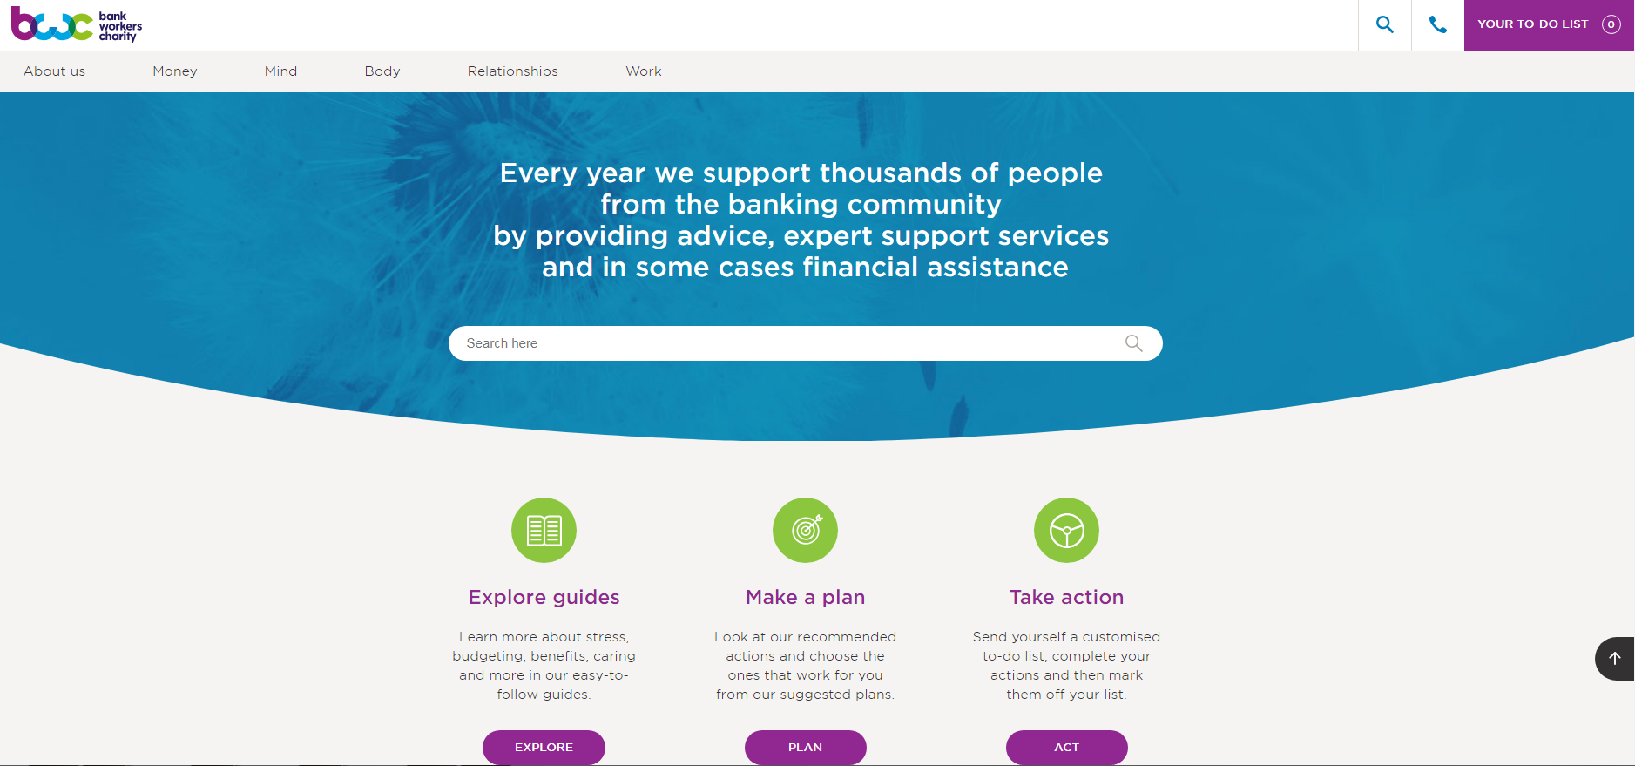
BWC Website

Slide 5
The rise of social wellbeing
2020 - Most major companies have a wellbeing strategy in place.
However, most pay little attention to social wellbeing, focusing instead on physical health, financial wellbeing and mental health
Social wellbeing was the tricky one - how do you address it?
The pandemic has changed everything – employers are concerned about the impact of long periods of isolation on employee wellbeing
The pandemic has seen a surge of mental health cases with an expected 500k new ones by the end of the pandemic
?

Slide 6
Social wellbeing – why is it so important?
Social wellbeing is important because we’re social animals
Social relationships are really vital to our health and wellbeing
Having close personal relationships has been found to be a better predictor of long-term life satisfaction than money, IQ, or fame.
Studies have found that even small-scale exchanges with other people make a big difference to our wellbeing,
Loneliness - the lack of social connection, has the same negative health impact as smoking 15 cigarettes a day .
Solitary confinement produces psychological damage - hallucinations; panic attacks; paranoia; hypersensitivity and difficulties with thinking, concentration and memory.

Slide 7
What do we mean by loneliness
“Loneliness is a subjective, unwelcome feeling of lack, or loss, of companionship. It happens when we have a mismatch between the quantity and quality of social relationships that we have, and those that we want.” From UK government’s loneliness strategy
Approximately 9m adults in the UK, more than a fifth of the population, “often or always” feel lonely -Red Cross
It’s not just a UK problem but worldwide. Almost (46%) of US people feel lonely some or all of the time Ipsos
1.02m office workers say they feel chronically lonely
It’s a widespread misconception that the elderly are the loneliest group in society – it’s the young.
3/4 of GPs have said they are seeing between 1 and 5 people a day suffering with loneliness.
In 2018 a Minister for Loneliness was appointed - Tracy Crouch

Slide 8
Why is there so much loneliness
The number of people living on their own has increased by 16% in the last 20 years.
There has been a decline is social connection as we became more wealthy
The most technologically connected generation are also showing the greatest signs of loneliness. YouGov, found 31% of 18 - 24-year-olds feel lonely often, or all of the time.
Social media may have a role to play for some age demographics. Individuals who spend more time on social media every day felt lonelier than those who spent less.
48% of us believe people are getting lonelier in general - Mental Health Foundation
.

Slide 9
Loneliness during the pandemic
Nearly a third of UK adults are suffering from loneliness in the latest lockdown Office of National Statistics (ONS)
Between 10 and 14 February, 29% of adults reported being lonely at times. Last year between 3 April and 3 May, it was just 5%.
Young people have again been disproportionately affected In a Covid impact survey, 80% of people under age 30 reported feeling lonely, depressed, hopeless, or nervous.
Overall the groups most affected by loneliness were the following. These remain the same as they were before the lockdowns:
The young
, Those who live alone
People on on low incomes
The unemployed
People who are living with a mental health condition.
.

Slide 10
The impact of loneliness
Paradoxically, loneliness can lead to us isolating ourselves more than ever
Physically, lonely people are more likely to suffer high blood pressure, obesity, increased inflammatory response, high cholesterol and poor nutrition, exercise and self-care.
People experiencing loneliness on a regular basis are also at increased risk of mental health problems and of cognitive decline
42% of people have felt depressed because they felt alone and loneliness is associated with risky behaviours like drug-taking and alcohol abuse. It’s also a known risk factor in suicide
Loneliness has a major negative impact on career development
”

Slide 11
Prevalence of workplace loneliness 1
A study from Relate found that 42% of people didn’t have any colleagues they would see as a close friend.
Mental health charity Mind found that over half (60%) of UK employees have felt lonely at work
Nearly three-quarters (70%) of office employees say they don’t know the people they work with very well Nespresso Professional.
Total jobs found that 63% of employees who are lonely feel their company doesn’t do anything to combat workplace loneliness.
Another survey of 7,800 office workers found that almost half (47%) think their employer doesn’t encourage them to get to know their colleagues, except professionally Nespresso Professional

Slide 12
Prevalence of workplace loneliness 2
The impact on employers
Workplace loneliness costs companies ￡2.5 billion a year.
Loneliness causes employees to take an average of 5 sick days a year.
Lonely workers say they are less engaged, less productive, and stay less time with their employer
They are twice as likely to miss a day of work due to illness and 5 times more likely to miss work due to stress
12 % of lonely workers say they believe their work is lower quality than it should be

Slide 13
Why are people lonely at work?
They may be working remotely
They may work with people of a different generation, or who are at different life stages, with whom they have little in common
Some people choose not to discuss their personal lives, focusing instead on work matters
Managers sometimes fear revealing too much of themselves and making themselves vulnerable
Some may be introverts, surrounded at work by extroverts (or vice versa)
Others may feel they don’t fit with the values or culture of the team or business
Office design may discourage personal interactions. Open office spaces have been found to discourage social contact
A shift to digital forms of communication may squeeze out direct contact

Slide 14
Who is lonely at work?

Slide 15
Who is lonely at work?

Slide 16
Personal experiences of loneliness
This person was the only member of her team based in the UK. Ultimately she became overtaken by loneliness.
“I didn’t see anyone — my team were based in New York. I missed the office banter. On Fridays they would say they were going for a drink and I felt excluded. I felt I was “out of sight, out of mind.”
This person felt lonely despite working in a busy office but the made it hard for her to seek help
“It felt so silly to feel lonely when surrounded by loads of people. It’s hard to talk to a boss and say, ‘I feel lonely.’ It’s not tangible. It’s not something you can explain very well. It’s not an easy conversation to have.”
Here’s the reflections of a home working employee who clearly misses the social dimension of working with colleagues.
“In the office it was companionship and friendships which made even the dullest or most challenging of days more bearable. There was a friendly colleague in moments of stress, somebody who could relate to the tough days, or the poor attitudes of another co-worker and somebody you could bounce ideas off, or just have a little chuckle with. There was company over lunch and a friendly ear when you wanted to have a little rant about some aspect of home life.”

Slide 17
Steps businesses can take 1
Managers need to become aware of loneliness as an issue and to watch out for any changes in behaviour that may signal there could be a problem
Regular managerial check in’s should take place - to connect with staff. These also give employees an opportunity to raise a concerns they have regarding their work life and mental health.
Employee networks can be a real asset bringing together people who already have something in common.
Talking about loneliness at work can help reduce the stigma and make it easier for people to seek help
Encourage employees on video calls to turn on the camera – it’s not the same as direct contact but seeing a colleague makes it feel more like it
Encourage staff working remotely to buddy up with and to check in with them regularly

Slide 18
Steps businesses can take 2
Team building projects can reduce loneliness by getting employees in dispersed teams to connect with and get to know each other.
Team lunches – are a good way great way for employees who haven’t worked together to interact and bond
Encourage direct contact between colleagues rather than digital communication when in the office.
Mix up teams or projects so that staff members can get to know more people than the team they joined when they started with the organisation

