Slide 1
Financial Wellbeing
Paul Barrett - Head of Wellbeing

Slide 2
About us
What we offer includes
BWC are the only UK charity supporting the banking community. We provide independent information, advice, services and financial support
The banking community makes up nearly 3% of the UK population. Across the UK there are 1.8 million people connected to banking, including former employees, their families, children and dependents
BWC Services are free, confidential and independent of banks

Slide 3
BWC services
What we offer includes
Help in managing mental health
Help with issues around disability or caring for someone
Assistance in accessing welfare benefits
Help with financial problems
Counselling for personal relationships
Bereavement counselling

Slide 4
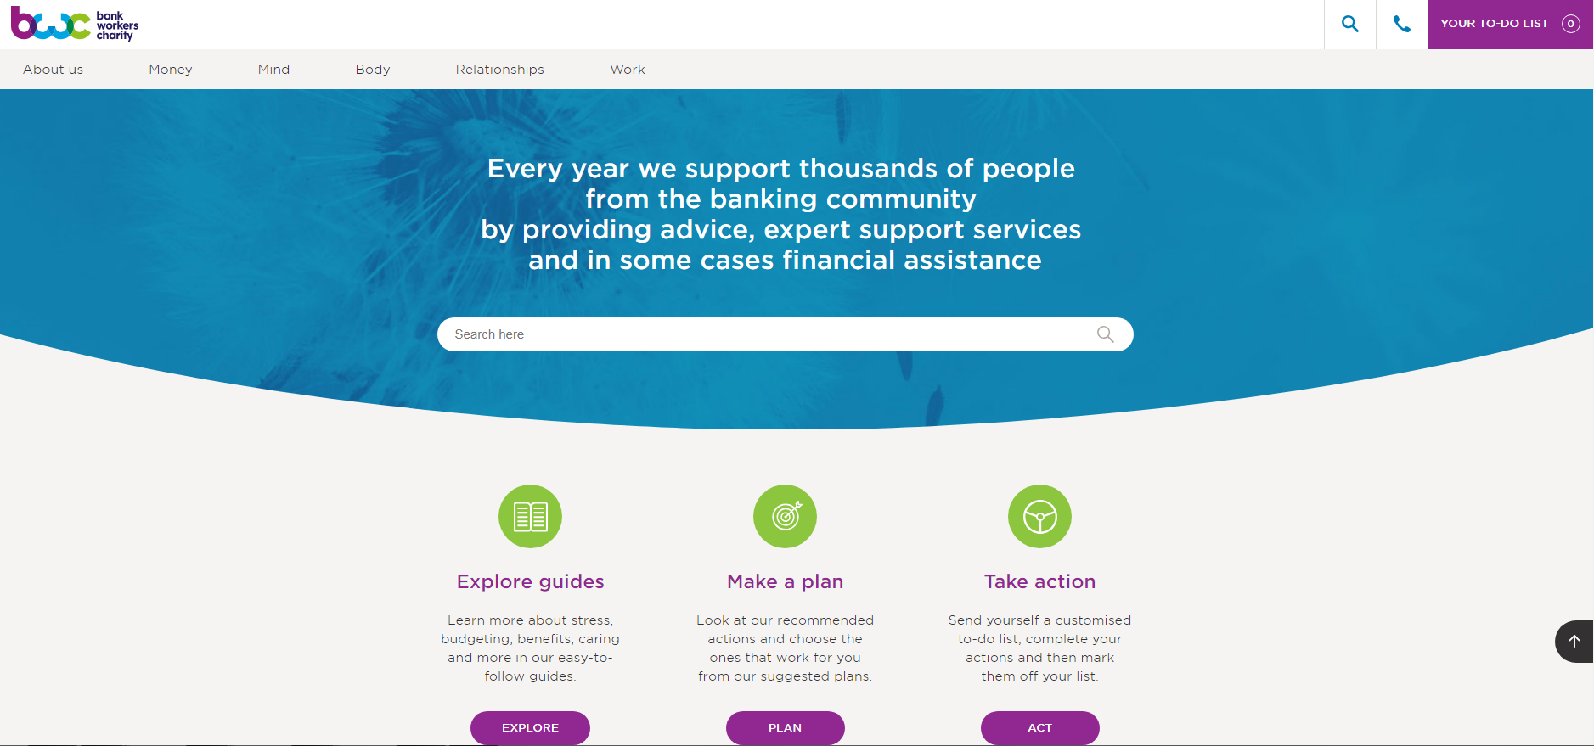
BWC Website

Slide 5
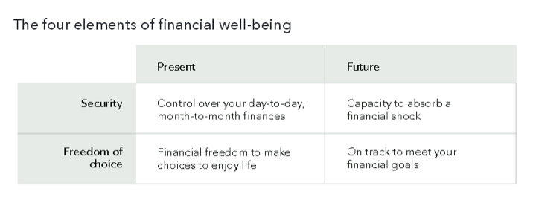
What is good financial wellbeing?
“A state of being wherein you have control over day-to-day, month-to-month finances; have the capacity to absorb a financial shock; are on track to meet your financial goals; and have the financial freedom to make the choices that allow you to enjoy life.” This definition applies to people whatever their income levels or situation

Slide 6
Even before CoVid-19 financial wellbeing a was an urgent issue
We’ve had over a decade of slow wage growth.
But the cost of living has risen significantly Between 2008 – 2015 wages rose by 9% but the basket of life’s essentials rose by 28%
Accommodation costs (rents and mortgages) soared by 10% in a single year 2015
An extended period of easy credit has encouraged many people to get into serious debt
There has been a rise in insecure employment including big growth in the number of zero hours contracts

Slide 7
Our financial wellbeing before the pandemic and since 1
JRF – In 2013, for first time, in-work poverty exceeded out of work poverty. It remains the case
YouGov survey - 1 in 3 middle class people couldn’t pay an unexpected £500 bill without borrowing
Money Advice Service - 4 in 10 UK adults have no more than £500 in savings
Neyber 2018 - 50% of UK employees regularly borrow to meet everyday living expenses and pay bills

Slide 8
Our financial wellbeing before the pandemic and since
9.6m people’s household incomes are 25% or more below the poverty line
June 2021 - 25% of UK workers said they were considering a second job to protect finances and 30% said they had been selling unwanted things to help make ends meet
And economists are predicting a very tough couple of years with rising inflation, soaring fuel prices and the impact of the war in Ukraine

Slide 9
The 2-directional relationship between money worries and mental ill-health
42% of those seeking debt help are prescribed medication to cope
People with money worries are 5 times more likely to suffer depression
CAB survey found - 74% said financial difficulties were affecting their mental health - more than half of these were having panic attacks.
If you’ve got mental health problems, you’re 3x more likely to be in debt
1 in 4 adults with a mental health problem are seriously behind on their bills

Slide 10
Financial difficulties and other areas of wellbeing
As well as affecting mental health, financial difficulties affect people’s
wellbeing in other ways too.
Financial problems are the single biggest cause of relationship breakdowns
CAB - 79% of people with debt worries lost sleep most nights
CAB - 54% experienced physical symptoms
A US study found financial problems were linked to many physical problems, like stomach ulcers, headaches, back pain and increased risk of heart conditions.
Poor financial wellbeing compromises social wellbeing, as financial constraints prevent people enjoying a full social life

Slide 11
How people fall into financial difficulty

Slide 12
Steps to good money management
Create a budget
Avoid impulsive purchases
Review your expenses
Save to fund future spending
Pay down any bad debt
Seek expert help

Slide 13
Bank Workers Charity – Financial support
Our website – preventative/educative tools like Money Health Check, Budget Planner, Benefits Calculator and a range of money guides
Financial grants – depending on the circumstances we can spend the charity’s money to support people in financial difficulties. These can range from support to help with short term crises, to more substantial long term problems. We need to ensure that other sources of financial support are not available.

Slide 14
Case studies – BWC financial support
25 year-old living man with mother. Both in difficulty She was furloughed but not eligible for funding. He had resigned from the bank to take up a new job but the job offer was retracted. The bank couldn't’ take him back. He wasn't eligible for furlough and had zero income. BWC is funded their day to day living costs till their benefits came through.
Client left abusive partner during lockdown. She had to flee family home but found safe private rental accommodation. BWC provided grant towards the essentials she needed, like furniture, bedding and crockery. We also funded counselling to help her come to terms with all that had happened.
Young employee moved out of the family home having taken up a fulltime job with a bank. The high rent put a huge strain on him financially and he ran out of money towards the end of each month. He was taking out payday loans and scrimping on food to get by. With financial advice and budgeting ng tools we got his finances into shape and we helped him with a living expenses grant that continued long enough for him to build up a financial reserve.

Slide 15
About
Are an independent charity. Last year, they helped over 600,000 people to take control of their debt problems
Their service is completely confidential
They don’t believe someone struggling with debts should have to pay to get help – their service is completely free
Their advisors are fully trained to give expert advice

Slide 16
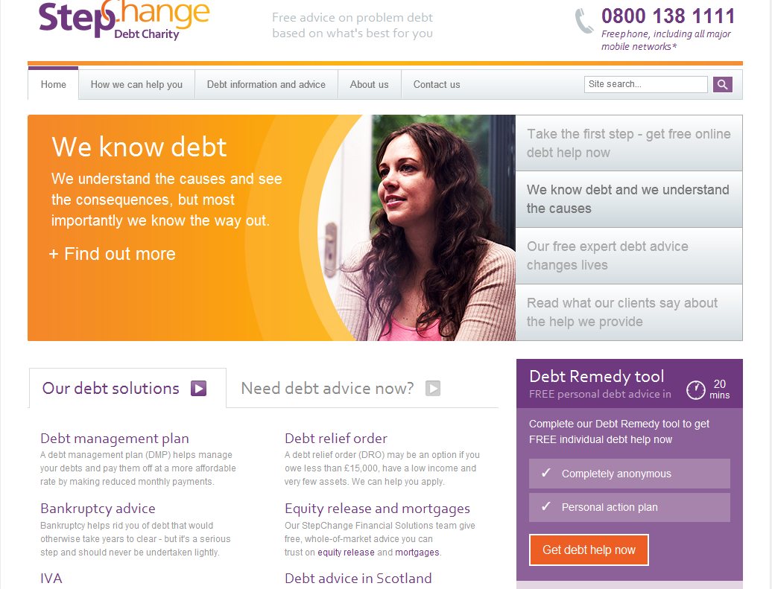
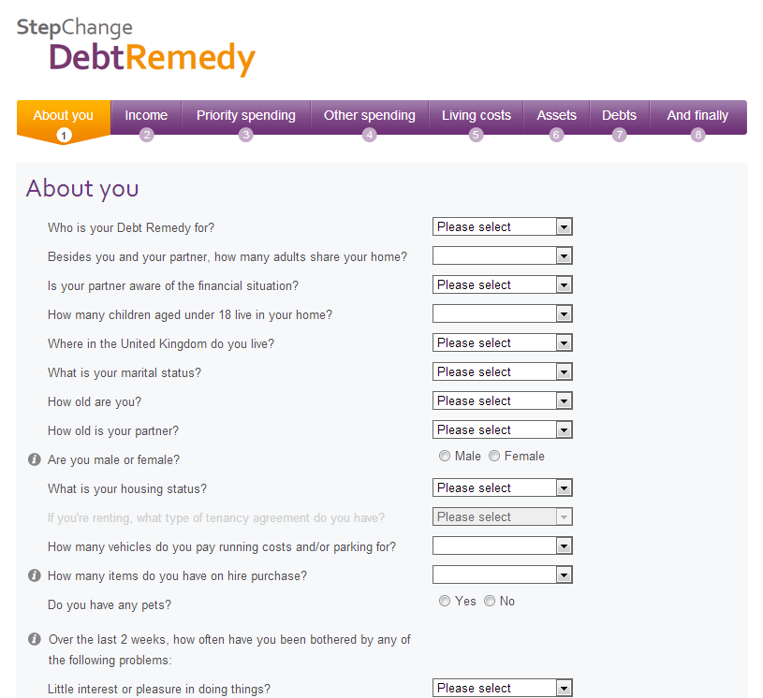
Online Advice – Debt Remedy
Debt Remedy mirrors telephone advice without speaking to an advisor.
Approximately 20 minutes to complete
Anonymous
Live web chat / Freephone number
Health and Wellbeing page

Slide 17
Get in touch
Our helpline: 0800 0234 834
Email us: hello@bwcharity.org.uk
Email me: paul.barrett@bwcharity.org.uk

