Slide 1
Children and Young People’s Mental Health
Paul Barrett - Head of Wellbeing

Slide 2
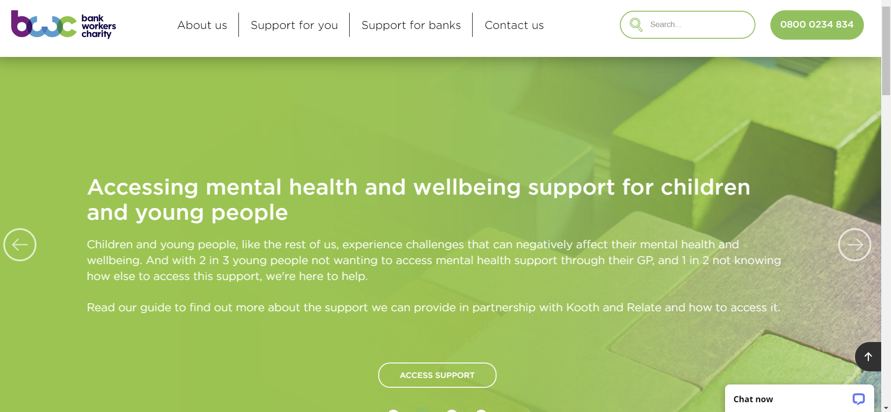
BWC Website

Slide 3
Common mental health problems among children and young people
Anxiety
Attention-deficit/hyperactivity disorder (ADHD)
Depression and other mood disorders
Schizophrenia
Eating disorders

Slide 4
Covid and the mental health of children and young people
Its not black and white. Some children's mental health (25%), even improved during Covid
But it was very difficult for many children. 80% of young people with mental health needs agreed the pandemic made their mental health worse (Young Minds)
1 in 6 children in England had a probable mental disorder in 2021 - up from one in nine in 2017 (NHS Digital)
Sleep problems increased markedly during the pandemic. There is a very strong relationship between poor sleep and mental ill-health
Eating disorders too were on the rise. 58% of 17 to 19-year-olds had possible eating problems in 2021, and that was up from 44% in 2017
Centre for Mental Health estimate that 1.5m children and young people may need new or additional mental health support by the end of the pandemic
Self harming also increased. In secondary schools, instances of self harm doubled during the 2020 autumn term compared to the previous year (Place2Be)

Slide 5
Spotting the signs
Physical
Emotional/Psychological
Changes in appetite
Disrupted sleep patterns
Rapid loss of weight or weight gain
Teeth grinding
Loss of hair
Self-harm
Wetting the bed more often
Frequent headaches and stomach aches
Crying more than usual
Persistent sadness – for 2 or more weeks
Irritability and aggression
Drastic changes in mood or personality
Appearing bored more often
Self harming or talking about it
Intense fears or worries that prevent normal activities
Significant drop in confidence / self esteem
Behavioural
Talking about morbid topics e.g. death or suicide
Young children becoming clingy
Losing interest in friends and other things they like doing
Being reluctant to talk
Difficultly concentrating
Prolonged dip in academic performance
Avoiding or missing school
Changes in eating habits
Substance abuse

Slide 6
Having the conversation 1
Choose the right moment. Avoid times when they’re upset
Do plan in advance what you plan to talk about and say
Sometimes it helps to have the conversation in a neutral space. like when going for a walk or a drive
Using alternative communication channels like texting can sometimes help, esp early on, when talking may feel difficult
Try and begin the conversation in a gentle, open way with something that shows you care like “I’ve noticed you don’t seem yourself at the moment - is everything OK?”

Slide 7
Having the conversation 2
Help them understand that having a mental health problem doesn’t mean that there’s something wrong with them - many people have them and you can get through them
Give them reassurance – you love them, you’ll support them and you’ll always be there for them
Children may say things as a result of their condition that are hurtful - don’t take them personally.
Avoid saying things that may feel to them like you’re minimising what they’re going through
Get support from yourself. Counselling can be available locally or through your EAP

Slide 8
Social media and mental health
In 2020, nearly all children aged 5-15 years old went online
Just over half of 5-15 yr olds used social media sites or apps, rising to 87% of 12-15 yr olds
Over half of 12-15 yr olds had a negative online experience . Most common (80%) was being contacted by a stranger who wanted to be their friend
Links established between frequent use of social media and conditions like depression, anxiety, eating issues, social isolation, and increased suicide risk
One of the most well established links is between heavy social media use and poor body image and self esteem

Slide 9
Social media – what can parents do?
Set realistic boundaries on social media use
Explain about cyber-bullying
Talk to them about the apps and platforms they use
Lead by example
Talk to them about the difference between private and public posts
Let them know they can talk to you about social media

Slide 10
How can the Bank Workers Charity help?
Notes:
2 out of 3 young people do not want to access mental health support through their GP.
Simple anonymous sign up.
Connect the user with others in their age group, so an 11-year-old won’t see the same threads and topics as a 15-year-old.
Different types of support to suit – magazine articles, Journal and goal setting, LiveChat with a counsellor, peer to peer support forums.
Everything is moderated, so it’s a completely safe environment for them, no risk of being cyber bullied etc.

Slide 11
Specialist support via our partnerships
Notes:
2 out of 3 young people do not want to access mental health support through their GP.
Simple anonymous sign up.
Connect the user with others in their age group, so an 11-year-old won’t see the same threads and topics as a 15-year-old.
Different types of support to suit – magazine articles, Journal and goal setting, LiveChat with a counsellor, peer to peer support forums.
Everything is moderated, so it’s a completely safe environment for them, no risk of being cyber bullied etc.

Slide 12
Our partnership with Kooth
Free, safe and anonymous emotional and wellbeing support for 11- 18-year-olds
Online chat available, 365 days a year
Access to live peer to peer, moderated forums
Self help articles and tools including mood tracking and goal setting
Access to online trained counsellors via drop-in or booked via text-based counselling sessions
Online magazine
Connect with a community and share stories, experiences, coping strategies and top tips
Mini activity hubs to support wellbeing and resilience
www.kooth.com/bwc
Notes:
2 out of 3 young people do not want to access mental health support through their GP.
Simple anonymous sign up.
Connect the user with others in their age group, so an 11-year-old won’t see the same threads and topics as a 15-year-old.
Different types of support to suit – magazine articles, Journal and goal setting, LiveChat with a counsellor, peer to peer support forums.
Everything is moderated, so it’s a completely safe environment for them, no risk of being cyber bullied etc.

Slide 13
Our partnership with Relate
Relationship counselling – for difficulties at home or at school
Relationships with others
Parents, siblings, teachers, friends, parents separating, mum or dad has a new partner, living with a stepfamily.
Bullying, cyber bullying, peer pressure.
Relationship with themselves
Self image, self harming, anger, schoolwork pressure
Client feedback: “I cannot thank you enough. You have been a lifesaver; the sessions have been massively beneficial for us both and my child is doing better.”
Notes:
Relate helps them think about things in a different way to help improve their relationships

Slide 14
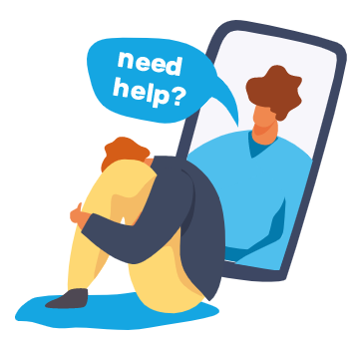
How to access the support available
Contact a client advisor at the Bank Workers Charity:
Or for more information visit:
BWC Guide on our website www.bwcharity.org.uk
www.kooth.com/bwc
www.relate.org.uk
Call us
0800 0234 834
Talk to us via LiveChat
(available on our website)
Email us
hello@bwcharity.org.uk
Notes:
Remember everything is free and confidential

Slide 15
Case Study
A lady contacted us to see if we could help her 6-year-old who was waking up in the middle of the night in tears, struggling with sleeping generally, feeling anxious and experiencing panic attacks. They had lost a family member (the child's grand parent) recently which was having a huge impact on the child's anxiety levels.
She had spoken with their GP who had made a referral to CAMHS, but in the area where they live there is a long waiting list.
We referred the family to Relate for counselling, where the initial sessions will be with the parents but then potentially include the child.
We also encouraged them to speak with the school for further support.

Slide 16
Case Study
We helped a 15-year-old girl who was struggling with severe anxiety during the exam period at school. Her mother had spoken to their GP who had advised that she was not eligible for support via CAMHS (Children and Adolescent Mental Health Services, an NHS service) as her symptoms were not severe enough.
The child was reluctant to get counselling through the school.
We referred her to Relate children and young people services for and initial 6 counselling sessions, but it was felt she needed a further 6 sessions to complete her therapy, which we were able to fund also.
We also referred her to Kooth.

Slide 17
Specialist help
Specialist care is available from your local Children And Young People’s Mental Health Services (CAMHS or CYPMHS)
Most CAMHS have their own website, which will have information about access, referrals and more, including phone numbers, so you can get in touch directly for detailed advice.

Slide 18
Information and support
YoungMinds offers free confidential online and telephone support to anyone worried about the emotional and mental wellbeing of a child or young person up to the age of 25.
Free parents' helpline on 0808 802 5544 from 9.30am to 4pm, Monday to Friday
MindEd is an online e-portal offering free advice about children and young people's mental health for all adults.
MindEd for families is a branch of MindEd, intended to support parents and those caring for children and young people.

Slide 19
Information and support
Royal Society for Public Health’s New filters report shows some steps taken and tools available to protect against adverse effect of social media on mental health https://www.rsph.org.uk/our-work/policy/wellbeing/new-filters.html
Parenting Mental Health Some of the best support, advice and information parents get is from other Parents. This organisation provides forums for parents to connect https://parentingmentalhealth.com/how-we-can-help/#
Place2be offer Parenting advice from child mental health experts Excellent short videos covering issues like safe social media, placing boundaries, dealing with anxiety etc. https://parentingsmart.place2be.org.uk/
CalmHarm – a free app to help manage the urge to self-harm https://calmharm.co.uk/
Meetoo – an app on which people of a similar age or experience can discuss problems and share experiences . The app is moderated. https://www.meetoo.help/

Slide 20
Get in touch
Our helpline: 0800 0234 834
Email us: hello@bwcharity.org.uk
Email me: paul.barrett@bwcharity.org.uk

