Slide 1

Pensions

Slide 2
What is a Pension
Tax efficient way of Saving for colleagues’ long term future
3 Main Types
Defined Contribution
Defined Benefit
State Pension
Contributions are a Percentage of income
Employer Matches some or all Contribution
Contributions are invested over the longer term and at retirement converted into benefits (member chooses – see later )
Contributions fixed – outcome variable
Income at retirement is known in advance
Usually based on a Formula:
Accrual Rate x Final Pensionable Pay x Pensionable Service = Pension
Contributions variable – outcome defined pension (and lump sum)
Depends on number of years that National Insurance contributions have been paid
In 2023 this is £10,600pa
State Pension Age is increasing

Slide 3
Pensions in Lloyds Banking Group
Pension Schemes are set up under trust to separate them from the Employer and to obtain tax reliefs. But what is a Trustee?
SCHEME NAME | ACTIVE | DEFERRED | PENSIONER | TOTAL | ASSETS (MN)
Lloyds Bank Pension Scheme No1 | 3,446 | 38,667 | 48,028 | 90,141 | 14,079
Lloyds Bank Pension Scheme No2 | 1,750 | 16,198 | 28,373 | 46,321 | 6,178
HBOS Final Salary Pension Scheme | 5,259 | 30,587 | 31,780 | 67,626 | 10,789
Scottish Widows RBS | 448 | 3,069 | 1,822 | 5,339 | 1,015
Main Defined Benefit Schemes
A Trustee is someone who holds and administers assets for the benefit of a third party.
Lloyds Banking Group Pensions Trustees Limited
Trustee Board – three Independent, three member-nominated and three employer appointed trustees
Terms of office dovetail – experience and consistency - appoint their own Chair
Look after Lloyds Bank Pension Scheme No1 & No2, HBOS Final Salary Pension Scheme, Scottish Widows RBS, Your Tomorrow
3 co-optees join Committees
Other Trustees
Lloyds Bank Offshore Pension Trust Limited – Jersey based and looks after Lloyds Bank Offshore Pension Scheme
Capital Cranfield Pension Trustees Limited – look after Equitable Pension Fund and Life Assurance Scheme
Administrators and Advisers
Willis Towers Watson administer all Schemes except for Scottish Widows RBS (Mercer now Aptia).
Allen & Overy in the main are legal advisers and Willis Towers Watson actuarial and investment advisers.
Your Tomorrow | 51,398 | 51,740 | 0 | 100,637 | 4,123
Lloyds Bank Pension Scheme No1 YT Section | 2,665 | 4,761 | 0 | 7,424 | 420
of your basic pay each month
Main Defined Contribution Schemes
DC SCHEME WITH A DB UNDERPIN
Lloyds Bank Pension Scheme No1 PIP Section | 0 | 29,786 | 0 | 29,786 | 780
Equitable Pension Fund & Life Assurance Scheme | 22 | 1,065 | 453 | 1,540 | 640
LB Offshore Scheme (incl PIP Section) | 10 | 661 | 555 | 1,226 | 249.9
MBNA (SW GPP) | 1,000 | 734 | 0 | 1,734 | 49
Others

Slide 4
All new joiners automatically enrolled in Your Tomorrow with effect from their first day of employment.
Now around 55,000 colleagues (c50,000 former colleagues) and around £4bn in assets.
All colleagues enrolled paying the minimum core contribution rate of 3% of base pay and will receive the minimum company contribution of 9% of basic pay.
More than 25,000 colleagues make contributions at 6% or more.
Colleagues make regular contributions directly from basic pay and will receive immediate tax relief and national insurance relief on these contributions if paid by Smart Saver (salary sacrifice).
If colleagues work less than full time hours then contributions collected on base pay and so reflect the hours worked.
Life Assurance for members of Your Tomorrow is up to 8 times base pay and generally payable at Trustee discretion and so outside inheritance tax. c1,000 colleagues are not members of any pension scheme and every 3 years will be re-enrolled to comply with legislation.
Pensions in Lloyds Banking Group
Your Tomorrow
You Pay 3%
Group Pays 9%
Total 12%
You Pay 4%
Group Pays 10%
Total 14%
of your basic pay each month
of your basic pay each month
You Pay 5%
Group Pays 13%
Total 18%
You Pay 6% or More
Group Pays 15%
Total 21% or More
of your basic pay each month
of your basic pay each month

Slide 5




Your Tomorrow Investment Options
Lifeplan
3 types Flexible Income, Annuity Income, Cash Focus
Defaulted into Life Plan Flexible Income
Fund manager/adviser decides split of investments
Lifestyle structure
>
Personal Choice
Range of 14 fund choices including Sustainable and Shariah options
You decide split of investments
You decide level of risk

Slide 6
Your Tomorrow
Retirement Options
1
Option to take 25% of fund as tax free cash AND/OR
Take the rest of the fund as cash – note taxed AND/OR
3
2
Buy a Pension with the fund (or the balance after cash). Type of pension down to choice AND/OR
Leave the fund invested and draw down in chunks (ongoing costs)
4

Slide 7
Defined Benefit Schemes
Most colleagues' benefits are based on
60th x Pension Service x Final Pensionable Pay = Pension
At retirement can give up pension for tax free cash (up to maximum limits)
Normal retirement date usually 60th birthday
Colleagues can take their pension benefits earlier or later than normal retirement date and benefits will be adjusted to reflect paid for longer or shorter period than expected
Earliest retirement age currently 55 (though protections for No2 members and some HBOS members) increasing to 57 from April 2028.
Colleagues who leave their DB Scheme without taking their pension benefits become deferred members and pension increases in line with inflation for each full year of deferment.
Pensions also increase in payment but different rules apply to these increases than to those in deferment

Slide 8
EXAMPLE
A colleague with 30 years service and pensionable pay of £30,000
As an active member of the Scheme pension increases by £500 per year (ie £30,000 divided by 60).
That same colleague will have a pension worth £15,000 (ie £30,000 x 30/60).
If the colleague opted out of the Scheme and, say, inflation was 3% then the pension would increase by £450 ie £15,000 x 0.03).

Slide 9
Pensionable Pay
Cap on increases to pensionable pay introduced in 2010 and frozen in 2014.
Cap is kept under review along with all methods of liability management for our defined benefit schemes.
Introduced by the Bank and implemented each time a pay award is offered.
Contributions
In the main non-contributory for the colleague but where colleague makes contributions or additional contributions then contributions collected directly from basic pay and will receive immediate tax relief and national insurance relief on these contributions if paid by Smart Saver (salary sacrifice).
Some Employer matching to additional voluntary contributions.
Colleagues working less than full time hours
If colleagues work less than full time hours then pension builds up at less than 1/60th in above formula ie half hours then 1/120th etc (pensionable pay will always be full time equivalent value to protect value of what has built up in the past).
Life Assurance
Life Assurance for members of DB Schemes is 4 times base pay (additional spouses/partners pensions) and generally payable at Trustee discretion and so outside inheritance tax.
Pensions in Lloyds Banking Group
Defined Benefits
If colleagues opt out of their DB Scheme and become deferred members then before pension benefits are put into payment a cash equivalent transfer value can be requested and paid.
Our Schemes saw a large number of transfers from 2016-2021 fuelled by pension freedoms and relatively high valuations but since reduced (adviser capacity and relatively low valuations).
Pensionable Pay Cap introduced in 2010 and reduced to 0% in 201`4.
Means that colleagues in our defined benefit schemes receive a fixed increase each year in their DB pension of (usually) 1/60th of pensionable pay.
Pensionable pay fixed so annual increase is fixed.
If colleagues opt to leave the DB Scheme their DB pension increases each year by the change in prices (capped at 5%).
Colleagues in our DB Schemes therefore have a choice of whether to remain in the DB Scheme or opt to leave and then decide whether to join Your Tomorrow.
See next slide for support available
Pension Scheme funding position is assessed every 3 years through a valuation. The object is to measure assets and ;liabilities and determine how much the Employer should pay into the Scheme in the next three years to pay for the benefits promised.
Valuations for the 3 biggest schemes are just completing and we’ll present formally to Accord on the outcome in the near future.

Slide 10
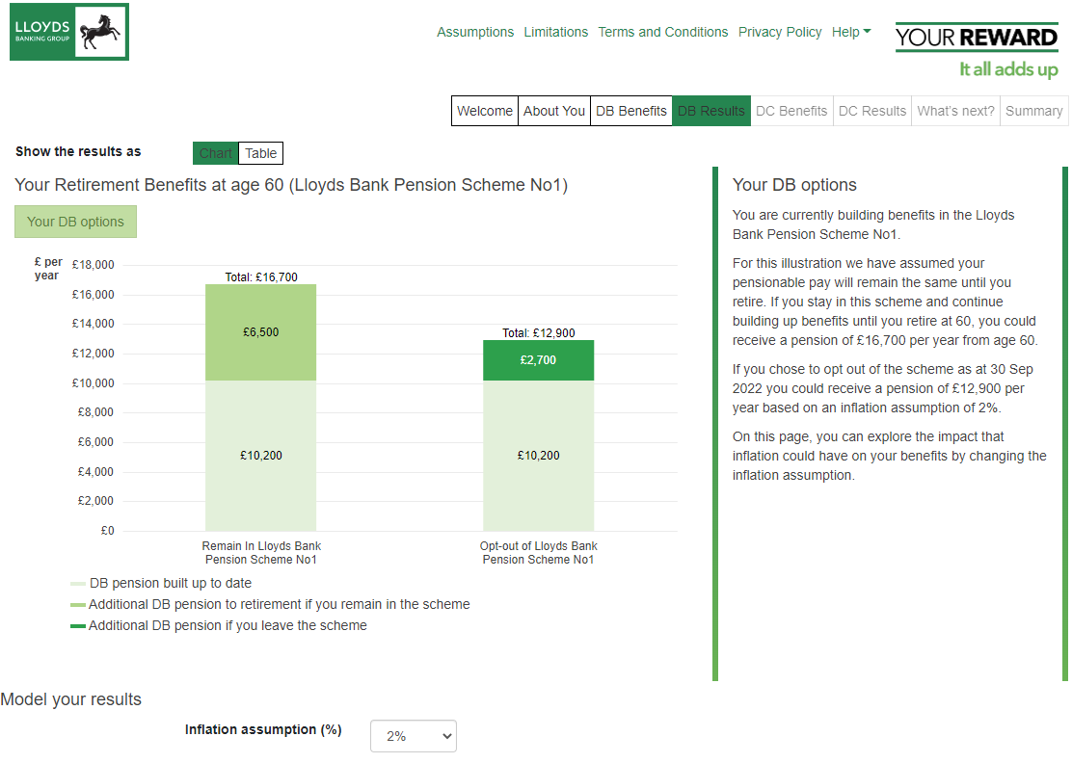
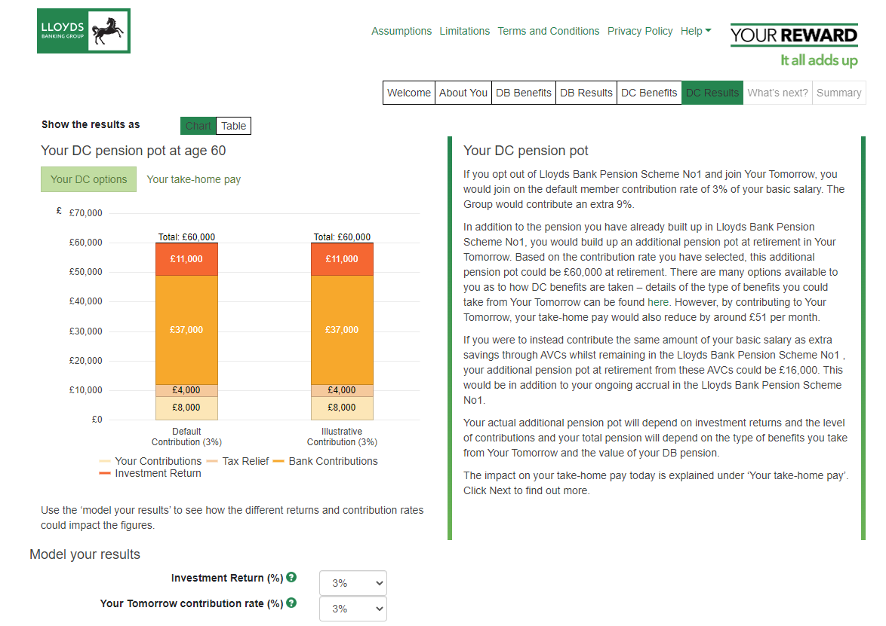
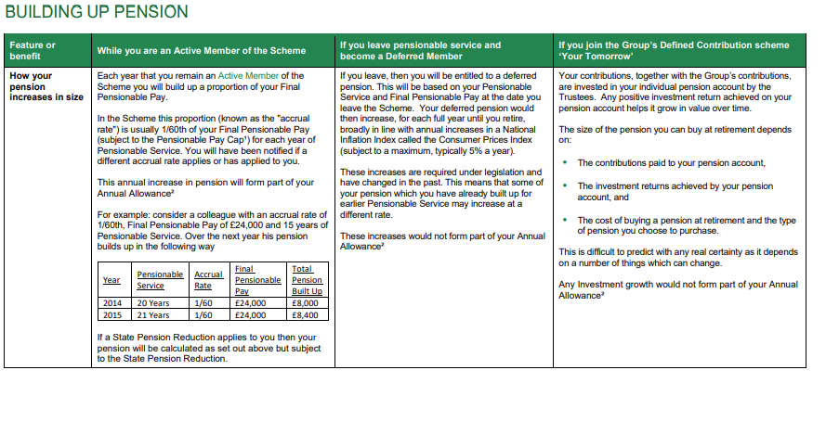
Defined Benefit Schemes
Modeller on Pension Reward Site under Useful Links
Scheme Benefit comparisons on both the reward site under the pensionable pay cap support and the external website document library

Slide 11
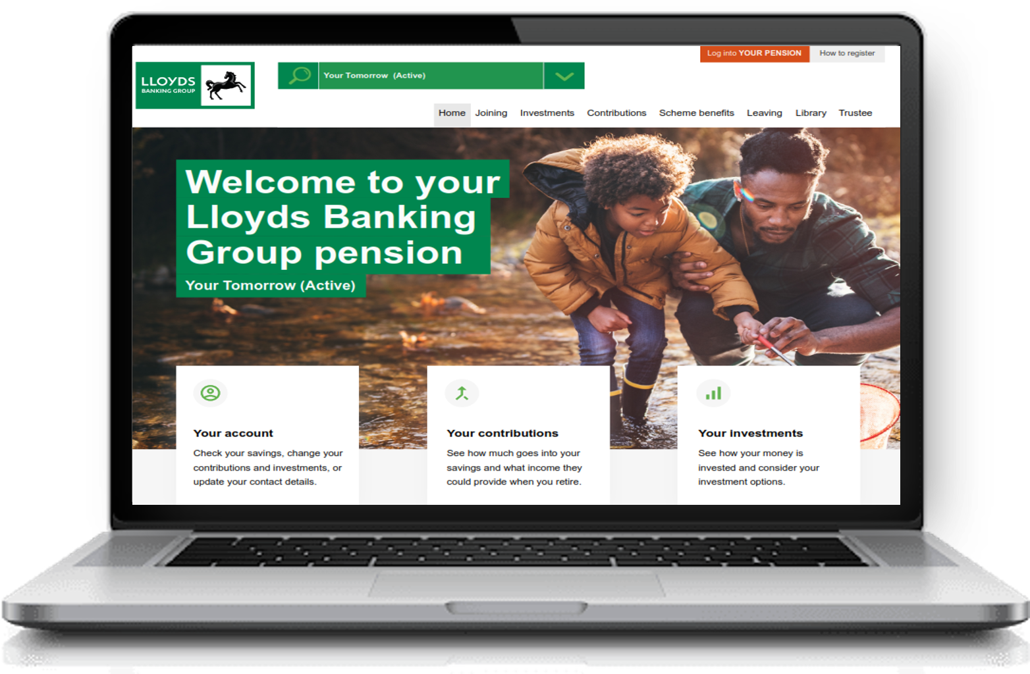
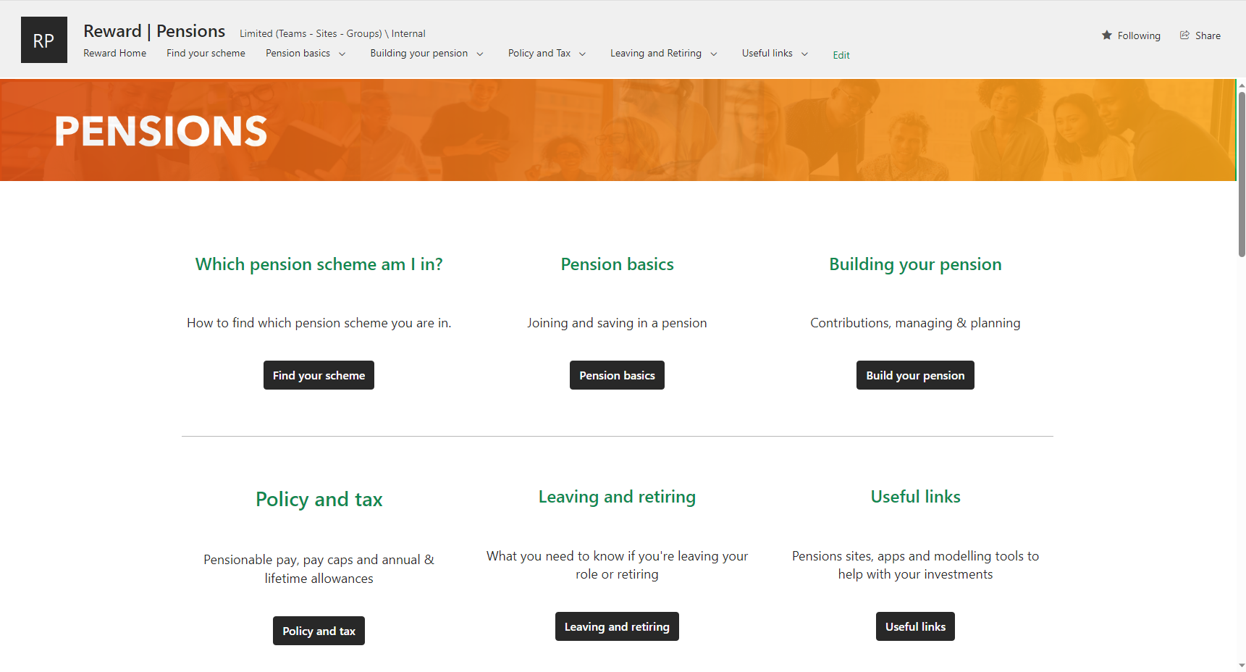

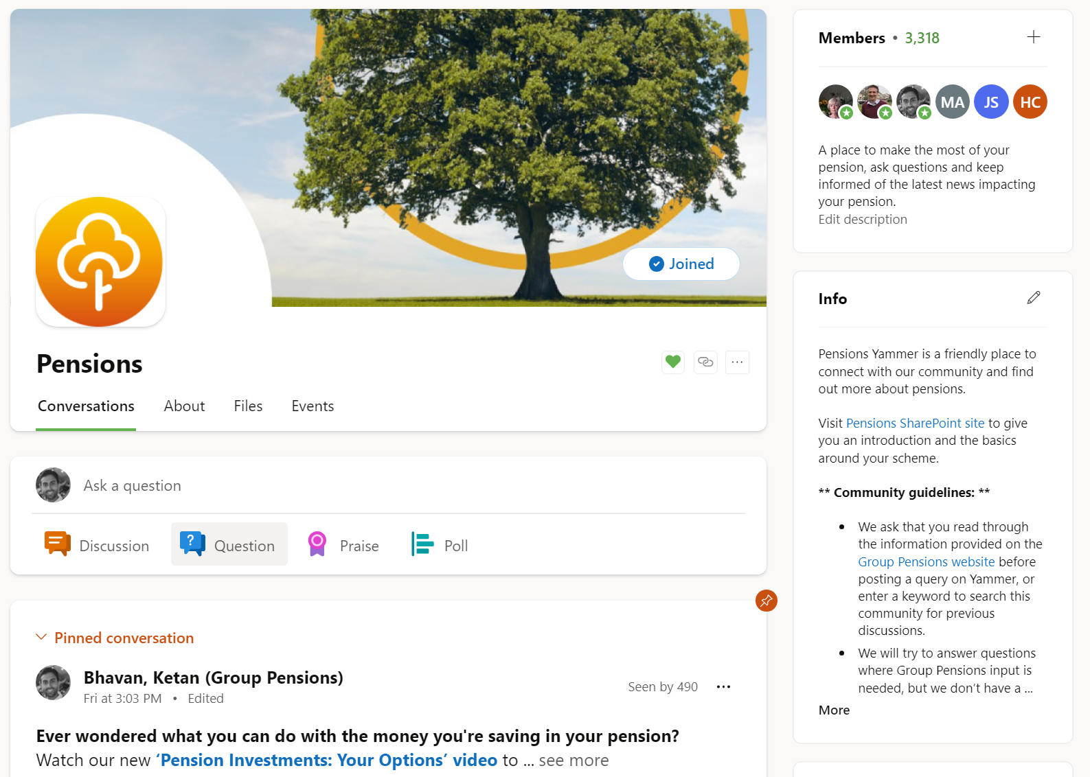
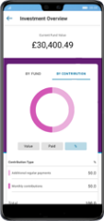
Where to find out more?
Pensions SharePoint
Group Pensions website
Helping you navigate pensions
Your home for scheme information accessible via single sign on
‘Your Pension’ account
Life@LBG > Reward > Pensions
lloydsbankinggroupensions.com
Pensions Viva Engage
‘Track My Pension’ app
Community chats
Access your account anywhere

Slide 12


Additional Support
www.pensionwise.gov.uk/LBGPTL
Life@LBG – Reward – Financial Products

