Slide 1
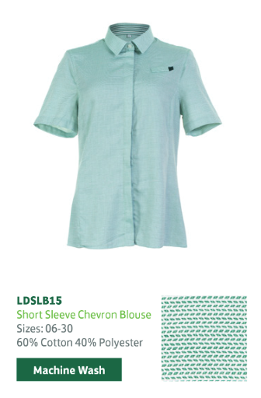
Helping you to managing common menopause symptoms in branch
Remember you can order more uniform items and bigger sizes
Consider what fabric you wear to best meet your needs
We have a range fabrics available to keep you warm in the winter and cooler in the summer
We have enclosed our suggestions for those of you who want a more breathable option

Slide 2
A guide to the fabrics used in our uniforms
Polyester
Polyester is an oil-based synthetic fibre and is the most widely used of all the man-made fibres. As such, it is the most common fibre used in corporate wear, due to its durability colour retention and strength.
Beneficial properties:
Polyester is the best wash-and-wear fibre, in that it is easy care, shrink resistant and quick drying. It maintains good stability and excellent colour retention.
Care considerations:
Polyester is not very breathable and if not cared for properly can have a tendency to have shiny appearance.
End of life possibilities:
In general, polyester is not biodegradable and therefore is not suitable for composting. However, polyester can be recycled into other end uses and can be produced from recycled plastic bottles.
Cotton
Cotton is a natural fibre, with a near-white matt or dull appearance. Sustainable cotton is available and can be supplied via Better Cotton Initiative. Cotton is used in a range of our garments, due to its natural soft handle and breathability.
Beneficial properties:
Due to its natural properties, cotton is non-allergenic. It is also breathable, maintains its strength when wet, and has good abrasion resistance. It produces no static build up.
Care considerations:
Cotton is prone to becoming creased and therefore requires more ironing than fabrics produced from other fibres. It can take a long time to dry naturally. Colour retention and shrinkage also tends to not be as good as synthetic fibres.
End of life possibilities:
Cotton is biodegradable, but it can also be reused. Cutting room waste can be recycled back into fibre form for re-use.
Source - Fibre Guide | Dimensions

Slide 3
A guide to the fabrics used in our uniforms
Wool
Wool is a natural fibre, obtained predominantly from the fleece of sheep. The quality of wool can vary, depending on its source.
Although wool is versatile, it is mainly used in our suiting fabrics, as it offers good abrasion resistance and natural moisture wicking.
Beneficial properties:
Due to its good abrasion resistance, wool is generally resistant to pilling. It has excellent absorbency and is breathable. Wool is a natural insulator, which means that it will help to keep the wearer warm or cool as required. Wool has a soft handle and is crease resistant.
Care considerations:
Wool shrinks easily and on its own, can be a relatively weak fibre, although dry cleaning can prevent shrinkage from occurring. It is expensive to process and difficult to wash and care for, compared to synthetic fibres.
End of life possibilities:
Wool is a natural fibre, so is biodegradable. It can also be recycled
Viscose
Viscose is a regenerated cellulose fibre, which is strong, durable and comfortable and is ideal to mix with polyester for corporate wear fabrics.
Beneficial properties:
Viscose is soft to handle and has good drape properties. It is breathable and absorbent, which adds to its comfort.
Care considerations:
Viscose tends to be weak when wet and is prone to shrinking. Viscose can pill and snag more easily than other fibres and can have a shiny appearance.
End of life possibilities:
As it is 100% cellulose, viscose is biodegradable. It also has potential for reuse and remanufacture and should not be sent to landfill.
Source - Fibre Guide | Dimensions

Slide 4
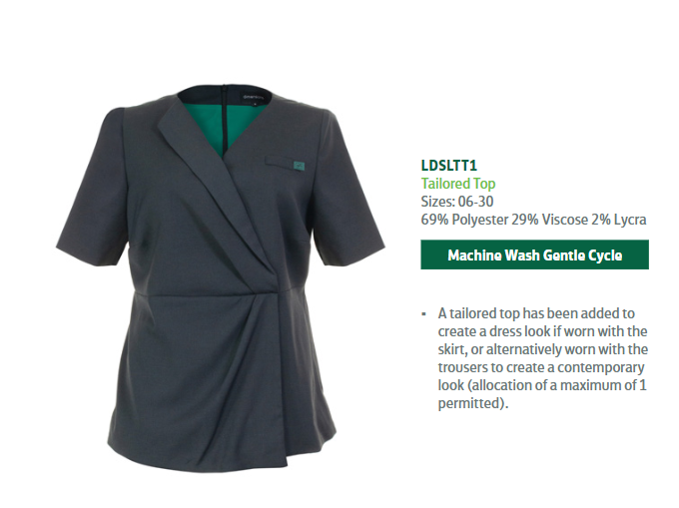
Menopause friendly Careerwear – the more breathable fabric options
Full uniform brochure

Slide 5
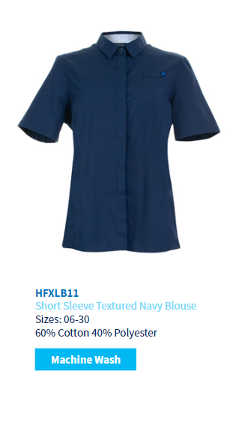
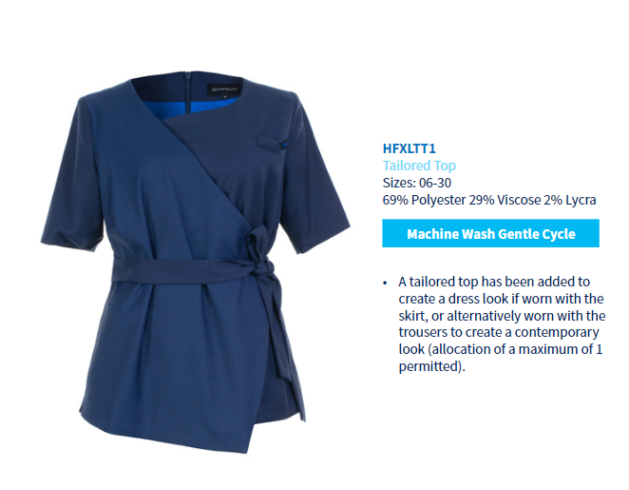
Menopause friendly Careerwear – the more breathable fabric options
full uniform brochure

Slide 6
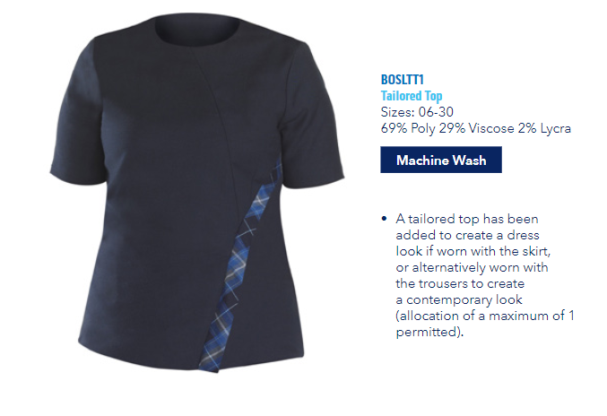
Menopause friendly Careerwear – the more breathable fabric options
Full uniform brochure

